Slide 1


E-commerce Revolution: Powering Growth with Data Engineering
"Harnessing the power of data to drive every click and cart."

Slide 2
Data Engineering
Introduction
They lay the foundation for the entire data ecosystem in a Sector.
They are driving efficiency, innovation, and customer satisfaction.
They turn raw data into actionable insights, helping businesses thrive in a competitive market.
In short, "Engineering a seamless shopping experience, fuelled by data."
Key Responsibilities
Data Quality Assurance
Data Integration
Designing and Building Data Pipelines
Database Management
Optimizing Performance
Data Security and Privacy
Collaborating with Stakeholders
Supporting Analytics and Reporting
Continuous Improvement

Slide 3




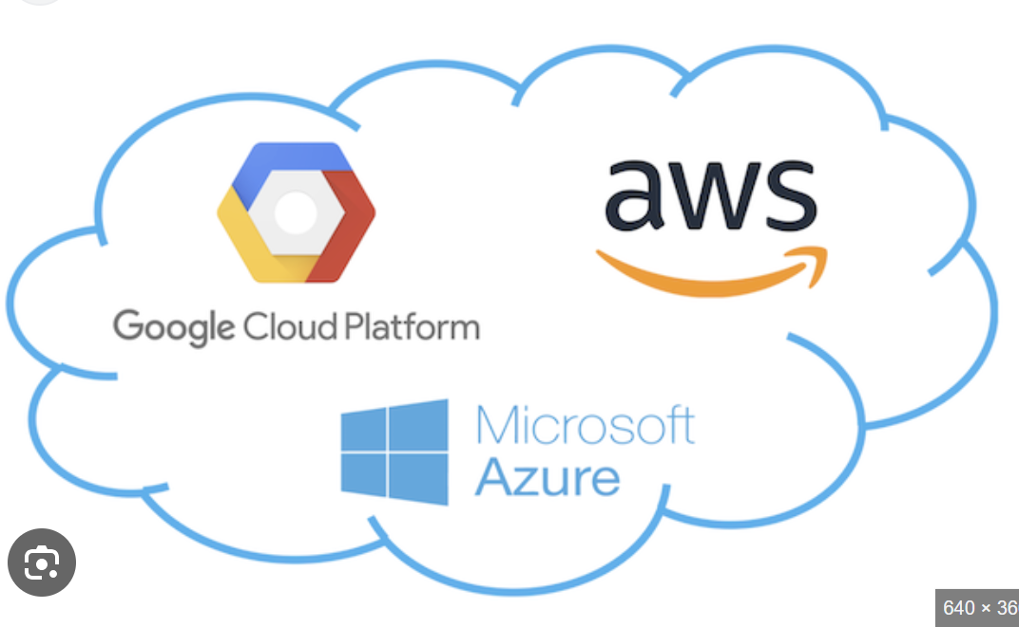













Data Flow in E-Commerce
Data Utilization
Personalized Recommendation
Inventory Management
Fraud Detection
Dynamic Pricing
Marketing Analysis
Continuous Improvement
Data Collection
Data Ingestion
Data Storage
Data Processing
Data Visualization
Customer Interaction
Real-Time (Kafka)
Data Lakes (Amazon S3)
Data Cleaning (Spark)
Descriptive Analytics (Power BI)
External Sources
Data Transformation (ETL)
FTP/SFTP
Data Warehouse (Redshift)
Predictive Analytics (Sagemaker)
Security & Compliance
Data Encryption - AWS Key Management Service, Google Cloud KMS
Access Controls – Casbin, Permify
Compliance – DataGrail, OneTrust
Batch Ingestion (AWS Glue, ETL)
Prescriptive Analytics
DB connectors
Data Aggregation (Flink)
Operational Data
Real-Time (Kafka)
Monitoring & Maintenance

Slide 4
Data Flow of Data Engineering in E-commerce
This shows a seamless flow from raw data collection to actionable business insights, enabling e-commerce to make data-driven decisions effectively.
Data Sources
Sources: Transactional systems, web logs, customer interactions, third-party APIs
Methods: Real-time data collection via tools like Apache Kafka, batch processing with Apache Nifi.
Data Ingestion
Tools: Apache Kafka, AWS Kinesis, Azure Event Hubs for real-time; Apache Nifi, Talend for batch
Process: Ingest data from various sources into data lakes and data warehouses
Data Integration
Design Models: Organizing data into structured formats for analysis like Time- Series Forecasting Model, Deep Learning Models
Schema Evolution: Adapting models to new data sources
Actionable Insights
> Customer recommendation
> Inventory Management
> Fraud Detection
> Dynamic Pricing
> Continuous Improvement
Data Processing
ETL Processes: Cleaning, transforming, and preparing data using Apache Spark, Talend
Stream Processing: Real-time analysis with Apache Flink, Apache Storm.
Data Storage & Management
Data Lakes: Amazon S3, Azure Data Lake Storage for raw data
Data Warehouses: Amazon Redshift, Google BigQuery, Snowflake for processed data.
Data Visualization
BI Tools: Tableau, Power BI for visualizing insights
APIs: Providing secure access to data for other applications
Security & Compliance
Access Controls: Implementing role-based access
Compliance: Ensuring adherence to regulations like GDPR, CCPA
Encryption: Protecting data at rest and in transit
Monitoring & Maintenance
Monitoring Tools: Grafana, Prometheus for performance and error tracking
Alerting: Immediate notification of anomalies
Notes:
Components Explained
1. Data Sources: This includes all the raw data collected from various sources such as transactions, market trends, customer interactions, social media, and external databases.
2. Data Ingestion Layer: This layer is responsible for the initial collection and loading of data into the system. It involves ETL processes, data pipelines, and real-time data streaming technologies like Apache Kafka.
3. Data Storage and Management: Once ingested, data is stored in data warehouses (e.g., Amazon Redshift, Google BigQuery) or data lakes (e.g., Hadoop, Azure Data Lake). This layer ensures data is organized, secure, and easily retrievable.
4. Data Processing Layer: This involves both batch and real-time processing of data. Tools like Apache Spark handle batch processing, while Flink or Storm manage real-time data processing, enabling timely analysis and decision-making.
5. Data Analysis Layer: Here, machine learning models (e.g., using scikit-learn, TensorFlow) and statistical analysis (e.g., using R, Python) are applied to interpret data, extract insights, and make predictions.
6. Data Visualization: Visualization tools like Tableau and Power BI create dashboards and reports, transforming raw data into understandable and actionable insights.
7. Business Applications: The insights derived from data analysis are applied to various business functions, including fraud detection, credit risk assessment, customer segmentation, investment strategies, and compliance reporting.

Slide 5
Analytics in E-commerce: Bridging the Past, Present, and Future
Descriptive Analytics
Usage: Summarizes past performance to understand trends and patterns.
Cognitive Analytics
Usage: Interprets complex data using AI and machine learning to provide deeper insights.
Example: Analyzing customer sentiment from reviews and social media posts, personalizing customer interactions through natural language processing
Diagnostic Analytics:
Usage: Identifies the reasons behind past outcomes and events.
Predictive Analytics:
Prescriptive Analytics:
Usage: Recommends actions to achieve desired outcomes based on insights from other analytics.
Example: Suggesting optimal pricing strategies, recommending personalized product offerings to customers, optimizing marketing campaigns.
Usage: Forecasts future events and trends based on historical data.
Example: Predicting future sales, customer churn rates, and inventory needs to ensure stock availability.
Example: Monthly sales reports, website traffic analysis, and customer demographics.
Example: Analyzing why a particular product's sales spiked or dropped, understanding the impact of a marketing campaign.

Slide 6
Metrics in E-commerce
Metrics in E-commerce are essential for evaluating E-commerce’s performance, health, and efficiency.
Here are some key metrics commonly used in the industry:
E-commerce Metrics
Sales Conversion Rate
Average Order Value (AOV)
Customer Acquisition Cost (CAC)
Customer Lifetime Value (CLV)
Shopping Cart Abandonment Rate
Returning Customer Rate
Bounce Rate
Net Promoter Score (NPS)
Product Pricing Strategy
Upselling & Cross-selling Techniques
Marketing Spend
Sales & Promotions
Customer Onboarding Process
Customer Retention Programs
Repeat Purchase Rate
Average Purchase Frequency
Checkout Process Optimization
Payment Options
Cart Recovery Strategies
Loyalty Programs
Email Marketing
Customer Engagement
Website Load Time
Content Relevance
User Experience (UX) Design
Customer Feedback
Satisfaction Surveys
Referral Programs

Slide 7
E-commerce Potential with Data Engineering
Personalized Customer Experiences
Customer Insights and Segmentation
Inventory Management
Fraud Detection
Supply Chain Optimization
Customer Support
Offer personalized recommendations and targeted marketing campaigns
Data engineering helps in predicting demand and optimizing inventory levels
By analyzing patterns and anomalies in transaction to detect and prevent fraudulent transactions
Analyzing transportation, warehousing, and distribution data can streamline supply chains, reduce operational costs, and improve delivery times.
By analyzing customer interactions and feedback, e-commerce businesses can improve their customer support services.
By analyzing customer behavior and preferences, we can segment the customers and tailor marketing strategies accordingly.
Amazon uses sophisticated algorithms to suggest products based on browsing and purchase history, significantly boosting sales and customer satisfaction.
Walmart uses data analytics to forecast demand for products, ensuring that popular items are always in stock while minimizing excess inventory.
PayPal can identify and block suspicious activities in real-time, protecting both the business and its customers.
Zara use data analytics to optimize their supply chain, ensuring that new fashion trends are quickly available in stores worldwide.
Zappos uses data analytics to monitor customer satisfaction and address issues proactively, leading to higher customer loyalty.
Netflix uses data analytics to understand viewer preferences and create personalized content recommendations, enhancing user engagement and retention.

Slide 8



Use cases in E-commerce
Revenue Forecasting Implementation
Pricing Optimization
To collect and analyze customer data from various sources to deliver personalized experiences and recommendations.
To collect and analyze data from various sources to determine optimal pricing strategies that maximize revenue and profitability.
Expense management
To collect data on expense from various sources, such as invoices, receipts & financial statements to optimise budgets & minimize expenses.
Tools Used:
Apache Kafka: For real-time data ingestion and processing of expense data from various sources.
Tools Used:
Google BigQuery: For storing and querying large datasets of customer information.
Tools Used:
Apache Kafka: For real-time data ingestion from sales, competitor prices, and market trends.
Apache Spark: For data cleaning, preprocessing, and initial analysis of expense data.
Amazon Redshift: For data warehousing and storing large volumes of expense data.
Power BI: For creating interactive dashboards and visualizing expense data.
SAP Concur: For automating expense management and integrating data from various sources.
Tableau: For detailed analysis and reporting of expense data.
Google Cloud Dataflow: For stream processing and batch processing of expense data.
Docker and Kubernetes: For containerization and orchestration of data engineering workflows.
Apache Spark: For processing and analyzing customer data at scale.
Snowflake: For data warehousing and managing customer data.
Amazon Personalize: For building and deploying personalized recommendation systems.
Tableau: For visualizing customer insights and trends.
Apache Airflow: For orchestrating and scheduling data workflows.
Docker and Kubernetes: For containerizing and managing scalable data applications.
Apache Spark: For data cleaning, preprocessing, and analysis of pricing data.
Google BigQuery: For storing and querying large datasets of pricing information.
Amazon SageMaker: For building and deploying machine learning models to predict optimal prices.
Power BI: For creating interactive dashboards and visualizing pricing insights.
Tableau: For detailed analysis and reporting of pricing data.
Apache Airflow: For orchestrating and scheduling data workflows.
Docker and Kubernetes: For containerizing and managing scalable data applications

Slide 9
Issues Solved by Data Engineering in E-commerce
Data Silos
& Integration
------------------------
Issue: Source data stored in different systems, making it difficult to integrate and analyze.
------------------------
Solution: Data Integration and Centralization Tools
------------------------Tools: ETL, Apache NiFi, Talend, Apache Kafka
Personalized Recommendations
-------------------------
Issue: Based on the behavior, data algorithms are developed for individual preferences and browsing history.
-------------------------
Solution: Building Recommendation Systems
-------------------------Tools: Apache Spark, Elasticsearch, TensorFlow
High Traffic
---------------------
Issue: During sales events and holidays we need to ensures the scalability of data to handle the increased load without performance degradation.
----------------------
Solution: Scalable Data Infrastructure
----------------------Tools: Azure, AWS, GCP, Kubernetes
Website Performance and User Experience
------------------------
Issue: Need to ensure seamless user experience, identify bottleneck and enhance whenever needed.
------------------------
Solution: Web Analytics and Performance Monitoring Tools
------------------------Tools: Google Analytics, New Relic
Price Optimization
------------------------
Issue: Setting the right price can significantly impact sales and profitability
------------------------
Solution: Dynamic Pricing Models Tools
------------------------Tools: Python (SciPy, NumPy), Apache Hive, AWS S3
Marketing Campaign
---------------------
Issue: To determine effective marketing campaign to optimize marketing spend.
----------------------
Solution: Marketing Attribution and ROI Analysis
----------------------Tools: Google Analytics, Apache Kafka, Apache Airflow

Slide 10
Business and End User Benefits
Business Benefits
Increased Sales and Revenue:
Benefit: Streamline operations by automating processes, reducing manual effort, and improving efficiency.
Techniques/Models: ETL tools (Apache NiFi, Talend), workflow automation (Apache Airflow), cloud computing platforms (AWS, Azure).
Scalability
Benefit: Ensure that e-commerce platforms can scale to accommodate growing data volumes and user traffic without compromising performance.
Techniques/Models: Cloud infrastructure (AWS, Google Cloud Platform), containerization (Docker, Kubernetes), distributed systems (Hadoop, Cassandra).
Fraud Prevention and Security
Benefit: Implementing robust fraud detection systems helps protect businesses from fraudulent activities, enhancing security and reducing losses.
Techniques/Models: Machine learning for anomaly detection (PyTorch, Scikit-learn), real-time analytics (Apache Flink, Apache Spark Streaming), security tools (Splunk, Datadog).
Benefit: Can optimize their marketing strategies, leading to increased sales and revenue.
Operational Efficiency
Techniques/Models: Data warehouses (Amazon Redshift, Google BigQuery), analytics platforms (Google Analytics, Tableau), machine learning models (TensorFlow, Scikit-learn).

Slide 11
Business and End User Benefits
End User Benefits
Faster Load Times and Better Performance
Benefit: Optimized website performance ensures faster load times, reducing bounce rates and improving user experience.
Techniques/Models: Web performance monitoring (New Relic, Dynatrace), content delivery networks (Cloudflare, Akamai), caching solutions (Redis, Varnish).
Better Customer Support:
Benefit: Enhancing customer support through data-driven insights and automated processes.
Techniques/Models: Chatbots(Dialogflow, Amazon Lex), Natural Language Processing (NLTK, SpaCy), customer support software (Zendesk, Freshdesk)..
Secure Transactions
Benefit: Protecting customers from fraudulent activities.
Techniques/Models: Secure payment gateways (Stripe, PayPal), encryption (SSL/TLS), fraud detection systems (FraudLabs Pro, Sift).
Easy Returns and Refunds
Benefit: Helping customers to streamline return and refund processes makes it convenient for users to return products and receive refunds quickly.
Techniques/Models: Return management systems (Narvar, Returnly), process automation (Apache Airflow, Zapier), CRM tools (Salesforce, HubSpot)

Slide 12
Growth of Data Engineering in E-commerce
These figures highlight the rapid growth of e-commerce globally and its increasing share of total retail sales
These companies have leveraged data engineering to enhance their operations, resulting in significant revenue growth and increased market share.
Year | Fastest-Growing E-commerce Countries
2019 | China, India
2020 | USA, UK
2021 | Brazil, Germany
2022 | Mexico, Indonesia
2023 | South Korea, Russia
2024 | Nigeria, Vietnam
Company | Key Data Engineering Tools Used | Revenue Growth (2024) | Market Share Increase (2024)
Amazon | AWS Glue, Amazon Redshift, Kinesis | 20% | 2%
Alibaba | Alibaba Cloud Data Lake Analytics, DataHub | 50% | 3%
eBay | Data Pipelines, Real-Time Analytics | 15% | 1%
Shopify | Shopify Plus, Data Integration Services | 25% | 2%
Walmart | Data Analytics, Machine Learning | 18% | 1.5%

Slide 13





Top Data Engineers leads in E-commerce
Leader | Company | Role | Contribution
Amanda Stansell |  | Senior Data Engineer | Improved Google's search algorithms and optimized data processes, keeping Google at the top of the search engine market.
Carlos Guevara |  | Principal Data Engineer | Managed Amazon's customer data analytics, optimized recommendation systems, and built robust data pipelines.
Yuna Park |  | Lead Data Engineer | Enhanced Alibaba's cloud computing and data storage services for real-time data processing and management.
Oliver Théron |  | Chief Data Engineer | Leveraged data at Spotify to drive decisions, enhance user experiences, and grow the business.
Jane Doe |  | Senior Data Engineer | Developed data pipelines and analytics solutions at Shopify, enabling personalized experiences and business success.

Slide 14








Top E-Commerce Companies
Company | Significant Work
 | Uses data engineering and machine learning for recommendations, logistics, and better customer experiences with real-time data processing.
 | Manages its vast e-commerce platform Taobao for customer insights, inventory optimization, supply chain efficiency, AI-driven fraud detection, and personalized marketing.
 | Integrates online and offline shopping with data-driven inventory, supply chain optimization, and personalized experiences.
 | Improves auction platforms with personalized recommendations, optimized search, and data-driven fraud detection
 | Improves loyalty programs and personalized marketing with customer data, offering tailored deals and better retention, while optimizing inventory and supply chains.
 | Integrates e-commerce with retail, using data to personalize shopping, optimize inventory, and improve supply chain efficiency.
 | Supports e-commerce platforms with data analytics for customer insights, marketing optimization, enhanced user experiences, and efficient inventory management.
 | Optimizes e-commerce platforms and enhances customer experiences through personalized recommendations and data-driven inventory management.

Slide 15
Final Thoughts
"In e-commerce, understanding your customer is key, and data engineering is the compass that guides you through the vast sea of information." - Jane Doe, Senior Data Engineer at Shopify
Data engineering is essential in e-commerce, offering numerous benefits for businesses and customers. It helps companies manage data efficiently, ensuring data quality and real-time processing. This leads to increased sales, operational efficiency, better decision-making, scalability, and enhanced security for businesses. Customers enjoy personalized shopping experiences, faster load times, better support, secure transactions, and easy returns.
E-commerce giants like Amazon, Alibaba, Walmart, and Shopify use data engineering to drive innovation and improve operations. As e-commerce grows, the need for skilled data engineers will increase, pushing further advancements in technology and data management. Future trends include AI, machine learning, cloud computing, and real-time data processing, making e-commerce more efficient, personalized, and secure.
In summary, data engineering is not just transforming e-commerce; it is setting the stage for future advancements that will redefine the landscape of online retail.

